Slide 1

RAVEN Introduction
RAVEN workshop
Presenter: Cristian Rabiti
PHYSOR 2016 – May 1st 2016, Sun Valley (ID)

Slide 2
Overview
Topological analysis
Data mining workflow
Time dependent data mining

Slide 3
Structured Sensitivity Analysis with Topology
(a) Construct Morse-Smale Complex
(b) Fit a linear regression model to each patch
Patches are assumed to be monotonic and thus we gain a meaningful set of sensitivity coefficients decomposed on the domain.

Slide 4
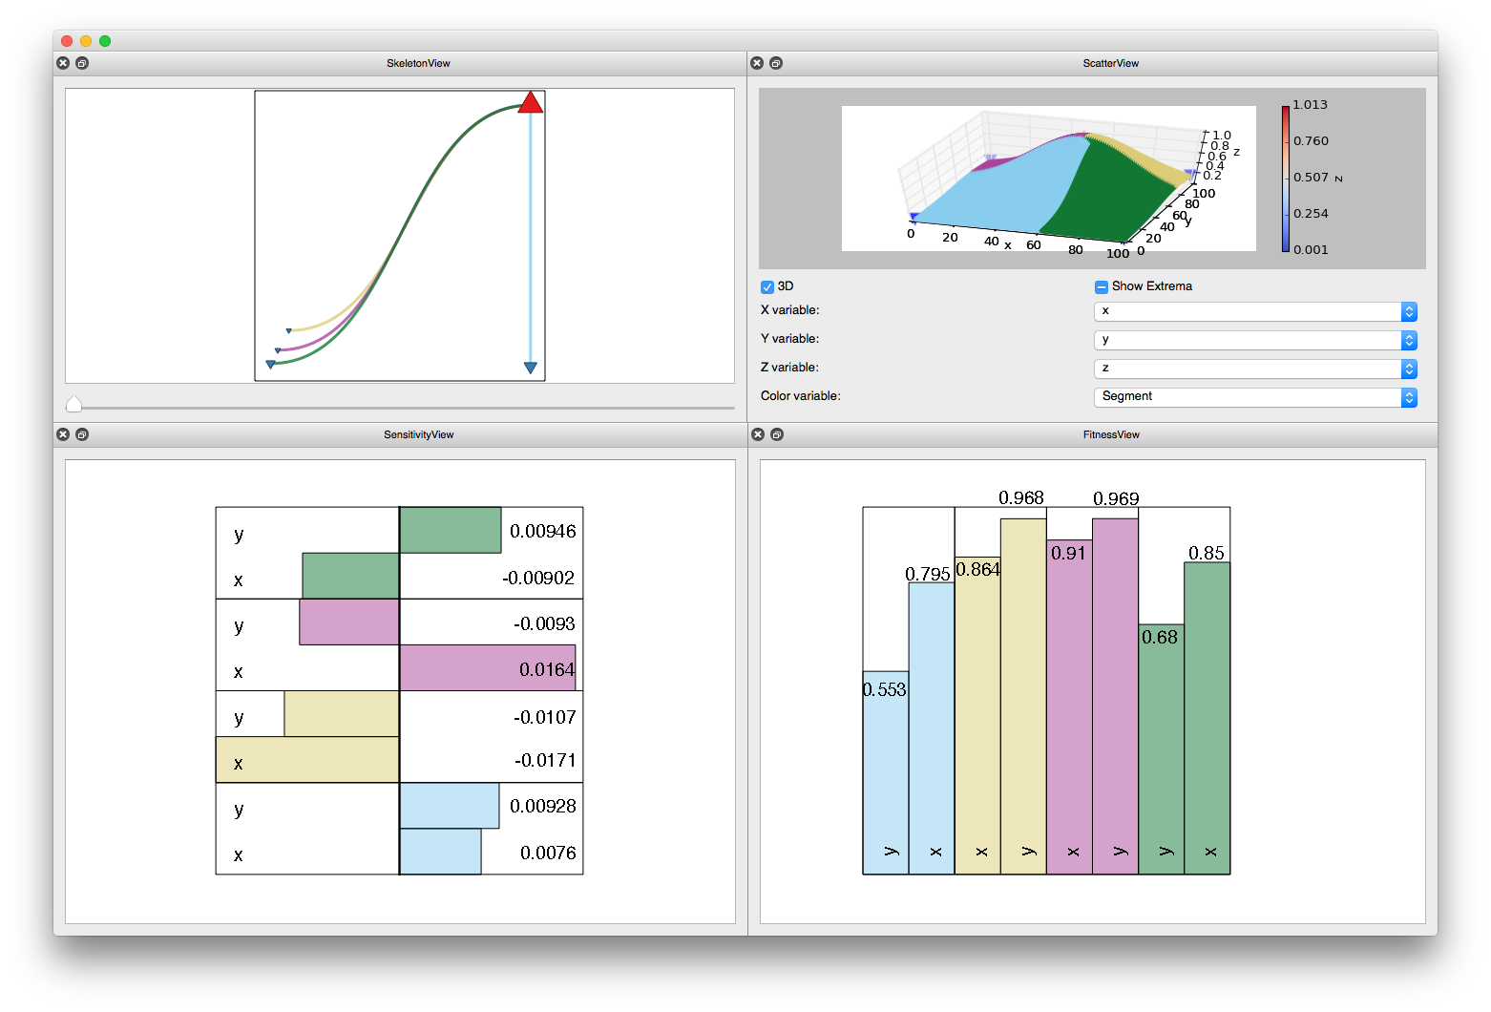
Interactive Interface for Data Exploration
Arbitrary scatterplot
projection into 2D/3D
Abstract topology representation
Ability to adjust simplification level
See flow from minima to maxima
R² coefficients from performing stepwise regression
Sensitivity coefficients

Slide 5
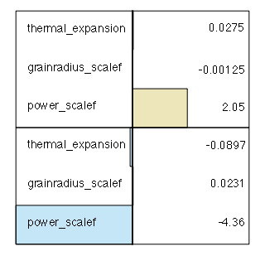
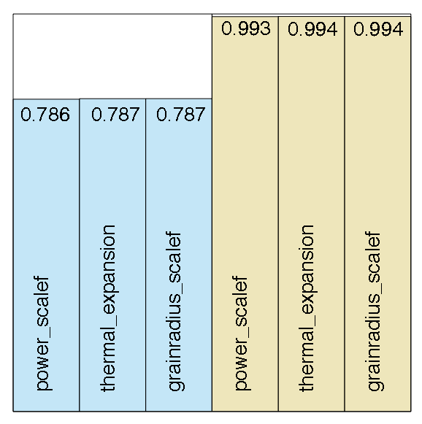
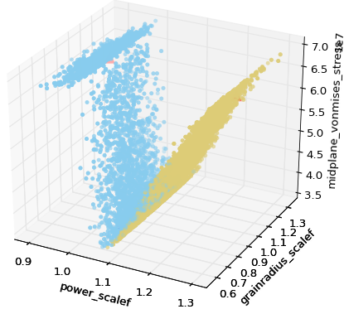
Application to BISON Fuel Analysis
~17,000 simulations
3 input parameters:
power_scalef = Power scaling factor of the core
grainradius_rscalef = Scaling factor of the grain size in the fuel microstructure
thermal_expansion = Thermal expansion coefficient of the fuel
Response value: Midplane Von Mises Stress

Slide 6
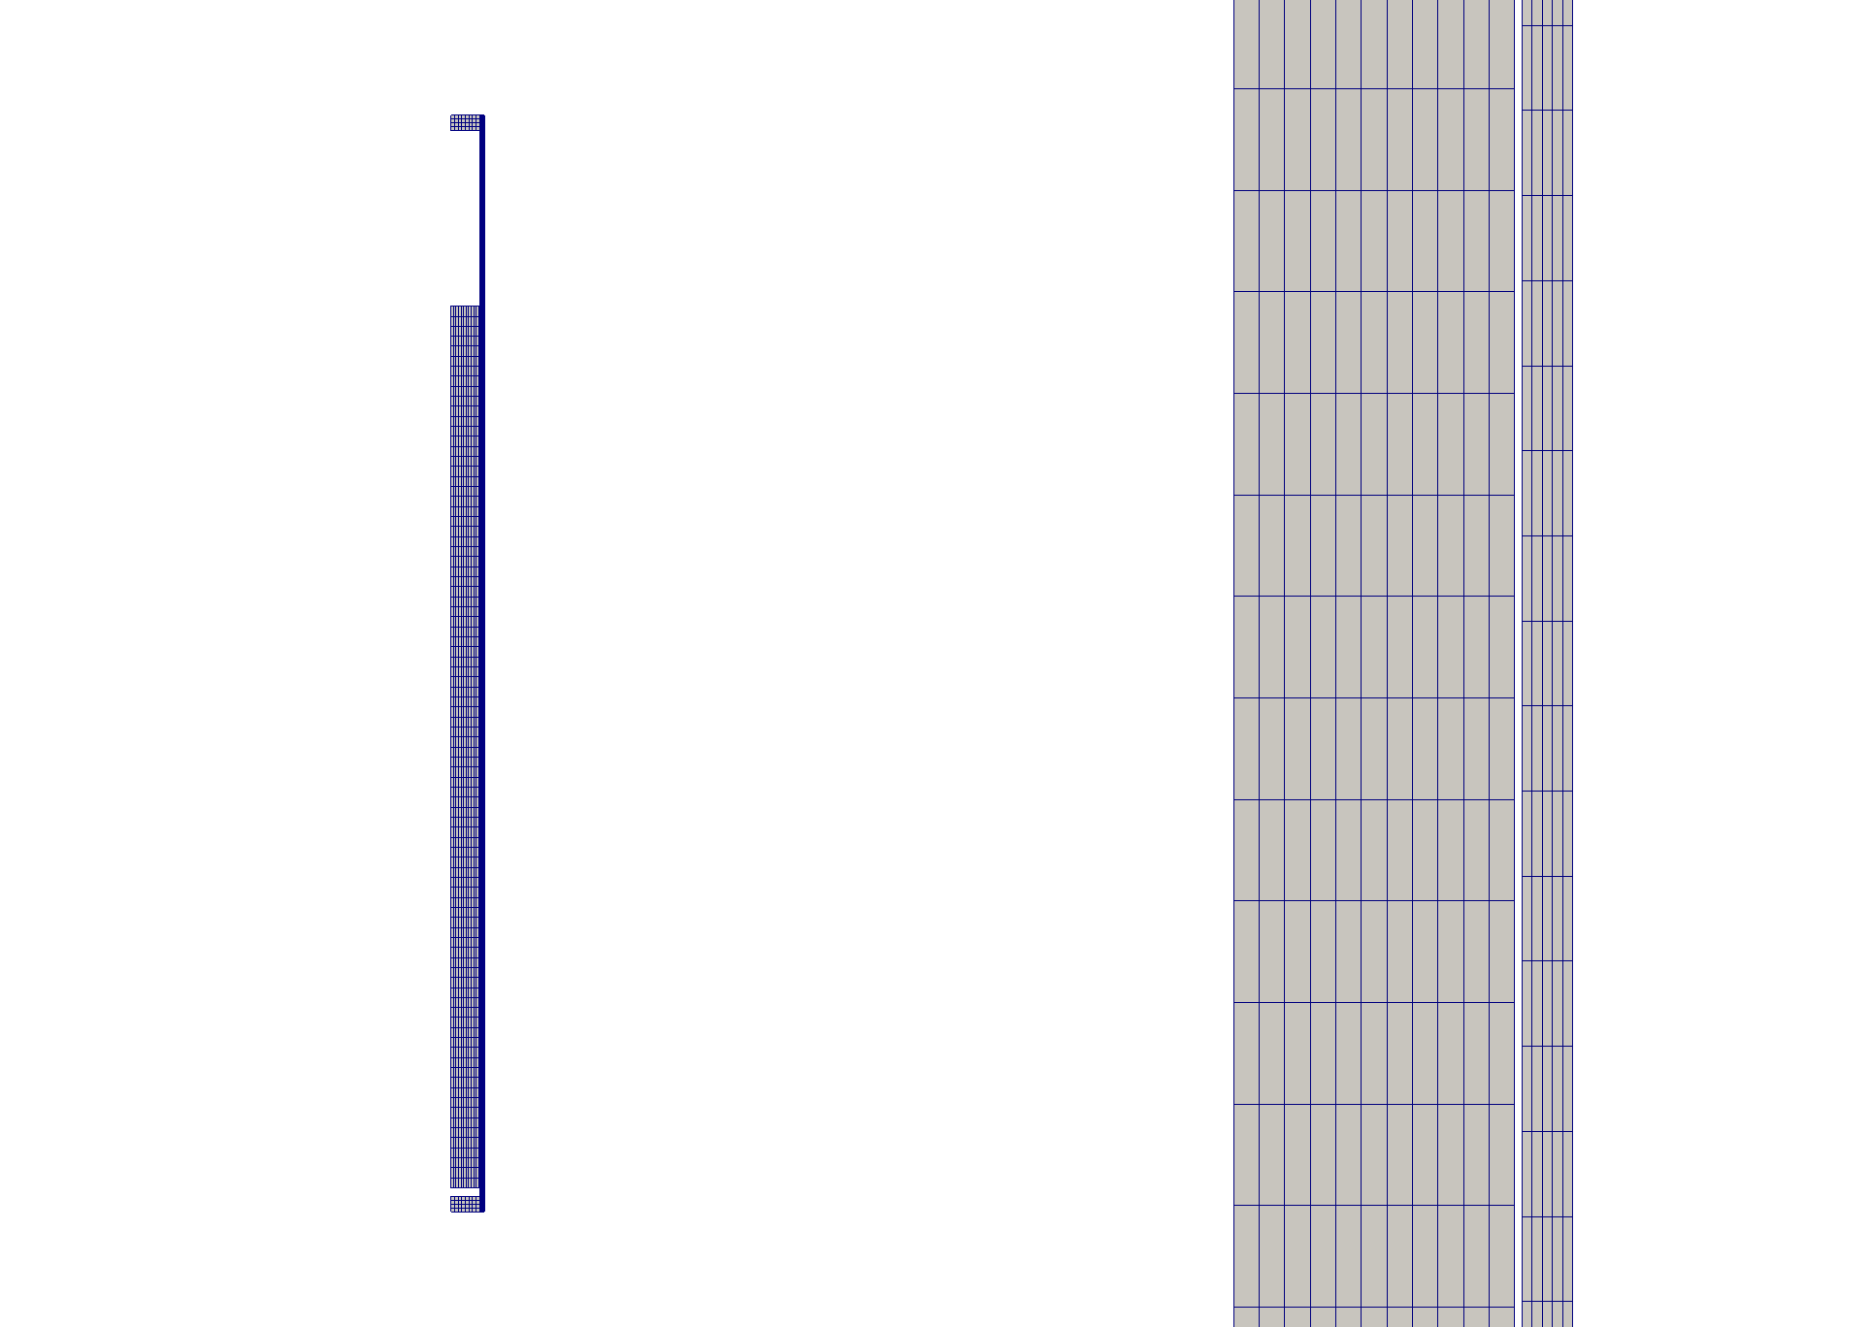
Input and Output Space in Bison Analysis
Input Parameters
Power scaling factor of the core
Scaling factor of the grain size in the fuel microstructure
Thermal expansion coefficient of the fuel
Output Parameters
Time of simulation
Maximum Stress
Maximum and mid-plane Von Mises Stress
Maximum and mid-plane Hoop Stress
Average Clad Temperature
Average Interior Temperature
Fission Gas Released
Centerline Temperature
Mid Plane Hoop strain (both clad and fuel)
Rod Power

Slide 7
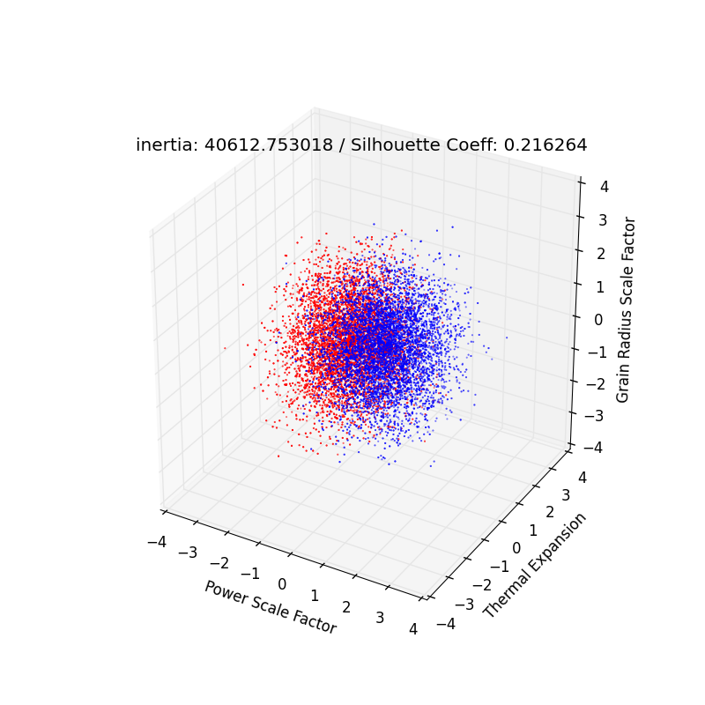
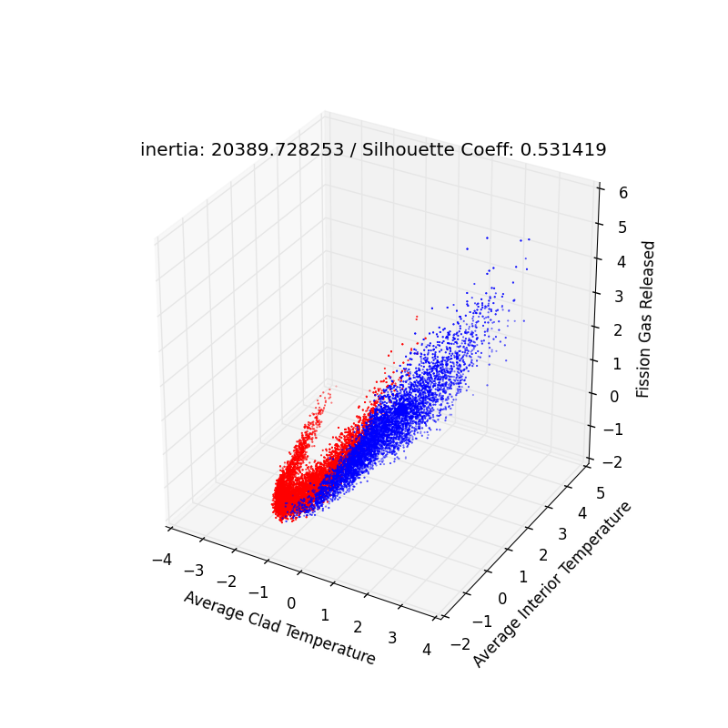
Clustering Analysis: Input to Output Space
Clustering in Input Space
Cluster labels from Input Space
Notes:
Left is the same as previous slide. However, now the right hand side shows the projection of the clusters in the input space to output space. (The inertia and silhouette coefficients at the top of each picture are for if the clustering were to be applied in the shown space, that’s why they are different.)

Slide 8
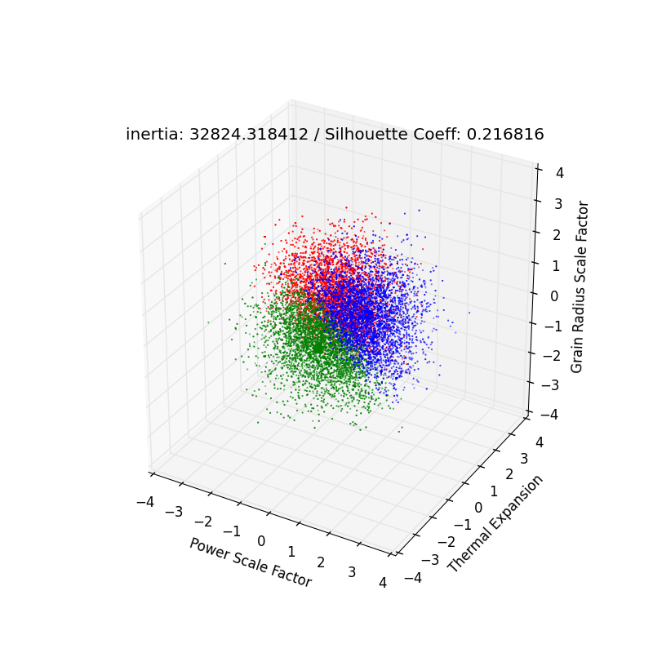
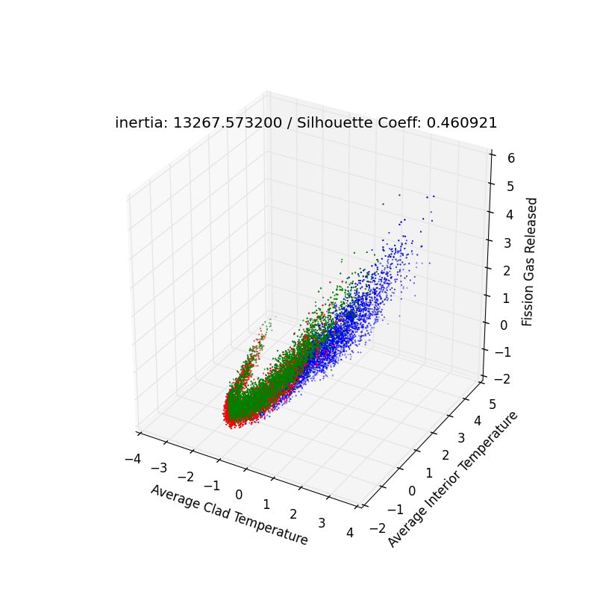
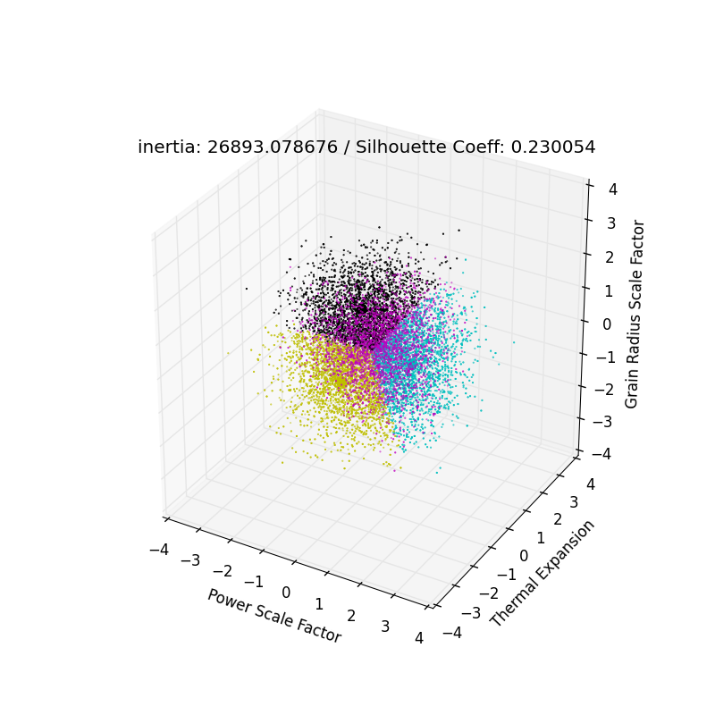
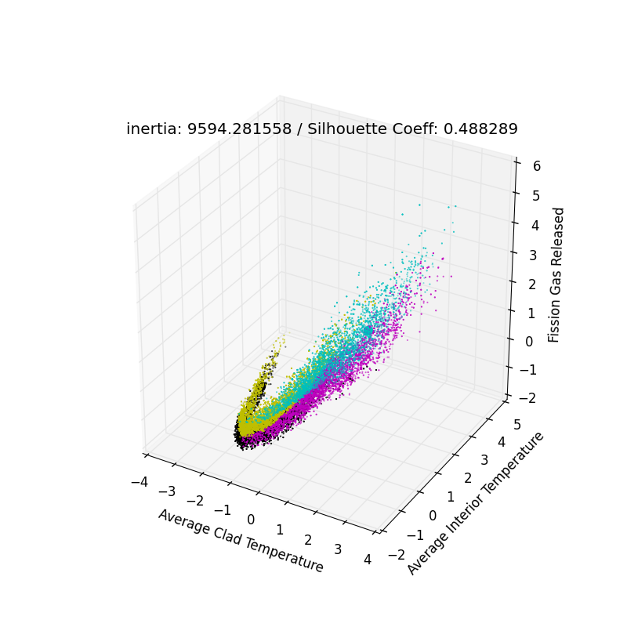
Clustering Analysis: Input to Output Space
Input
Output
Notes:
Here the Clustering analysis applied to input space are shown. Both is with using Kmeans algorithm with 3 and 4 Cluster at left and right, respectively.

Slide 9
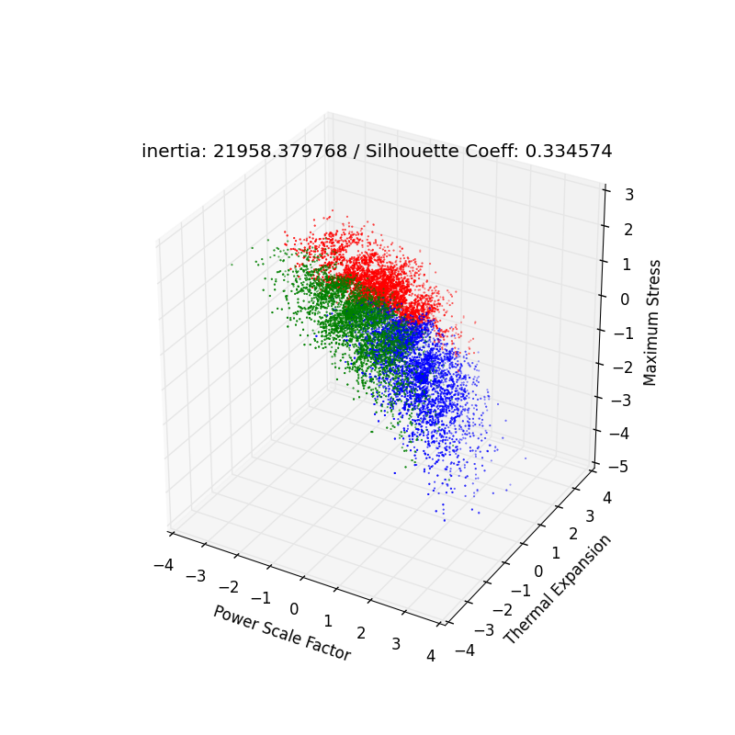
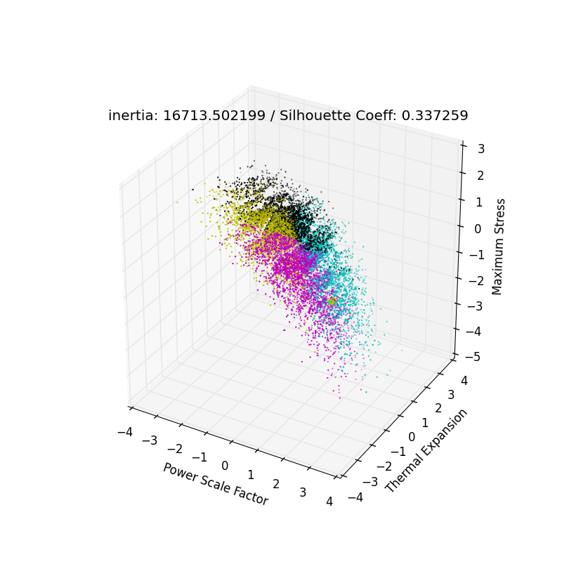
Clustering Analysis (Input to Input/Output Space)
Output
Input/Output
Notes:
Here the Clustering analysis applied to input space are shown. Both is with using Kmeans algorithm with 3 and 4 Cluster at left and right, respectively.

Slide 10
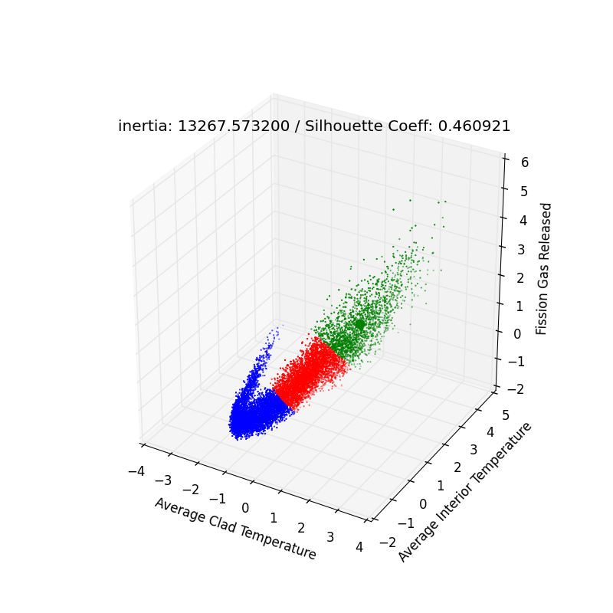
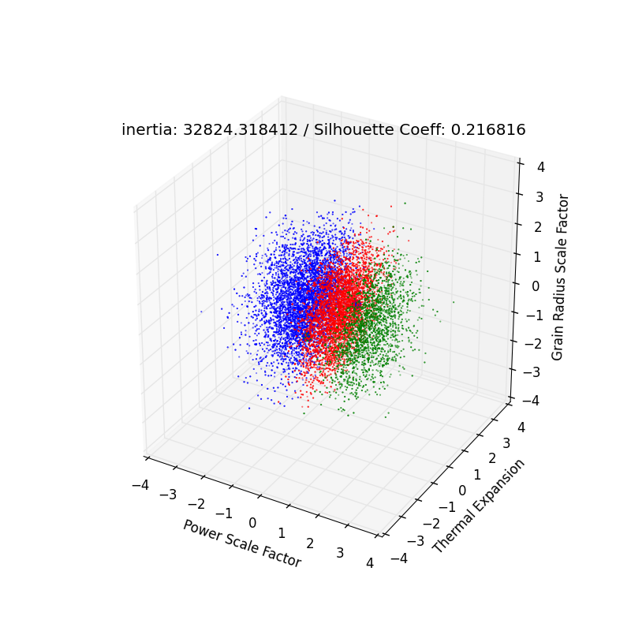
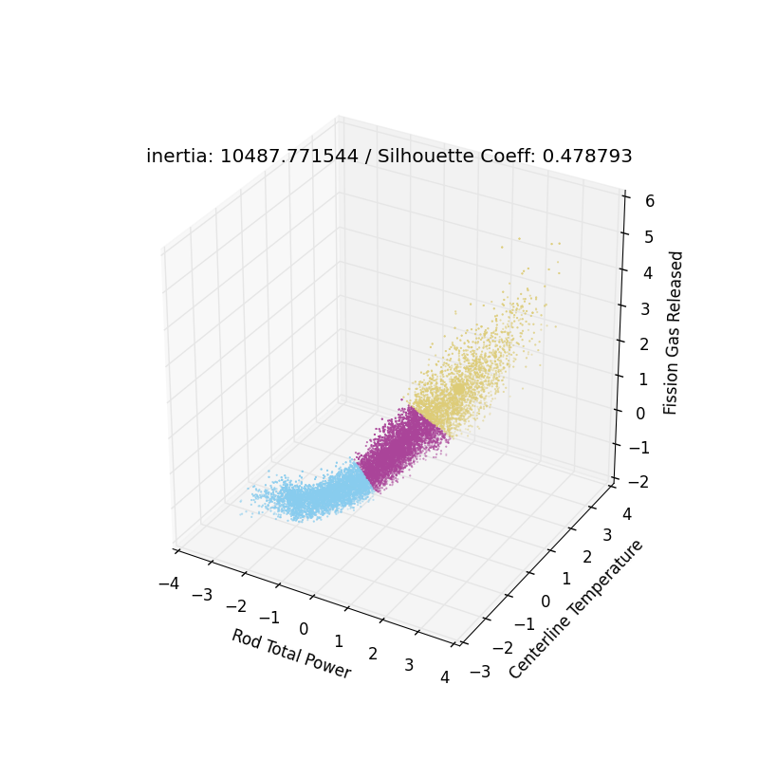
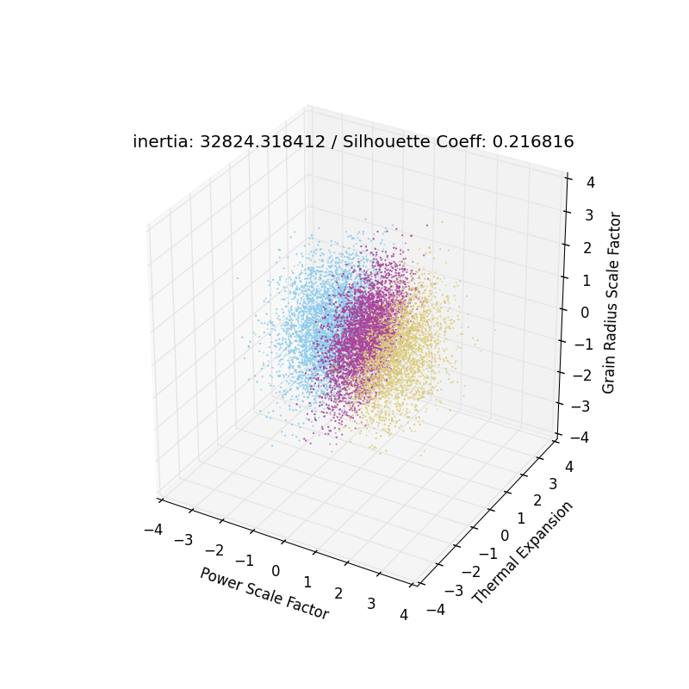
Clustering Analysis (Output to Input Space)
Output
Input
Notes:
Clustering applied to output space (to the 3 parameter shown in the axis of the left picture) and the labels are projected to the input space (the right picture)

Slide 11
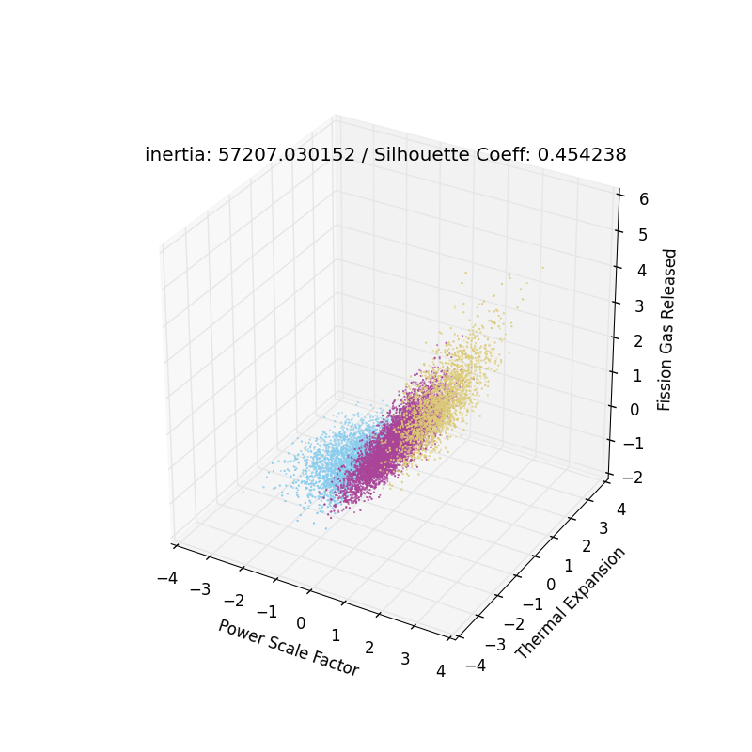
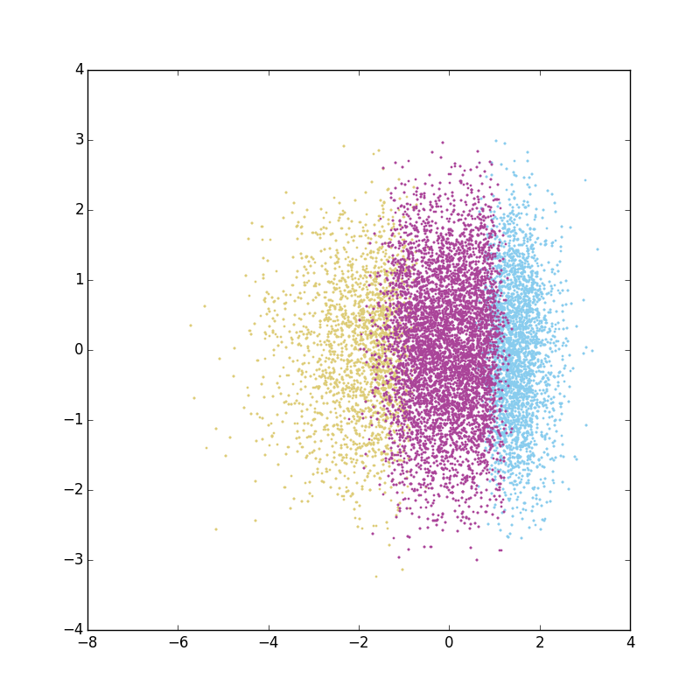
Clustering and Dimensionality Reduction
Output Space
Notes:
Clustering applied to output space (all the parameter used in the analysis shown in the table in slide #12), i.e. the labels (colors). Left figure shows the labels projected to 3 output parameters and the PCA decomposition (within RAVEN) is applied to see the clusters better in 2D. (the right picture cluster labels are same as left picture)

Slide 12
Data Mining Process Workflow in RAVEN
Generate a sampling strategy
Perform Uncertainty Analysis
Obtain Input and Output Space
Perform Data Mining
Analyze and Visualize Information
Update Input and Output Space Requirements
Adapt sampling strategy
Generate the data
Understanding the data

Slide 13
Data Mining on SBO Analysis
20000 data points with 12D input space and 1D output space
Clustering applied the max clad temperature (2 Clusters identified)
Covariance analysis applied to rank the input space
Clustering labels used to train a classifier with 3 most important inputs
A classifier is applied to the ROM output

Slide 14
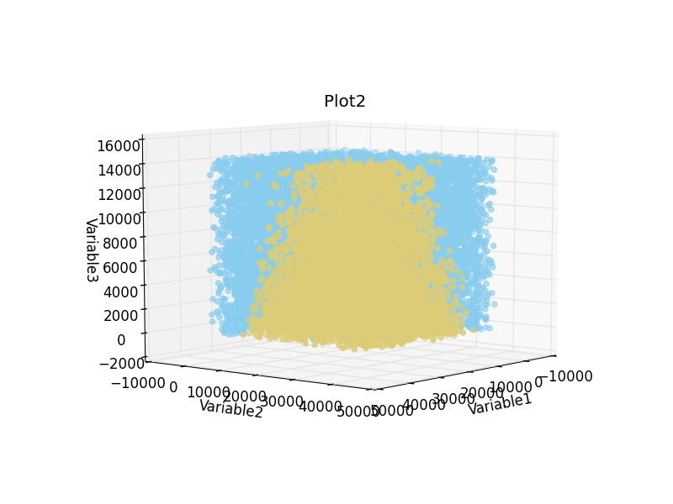
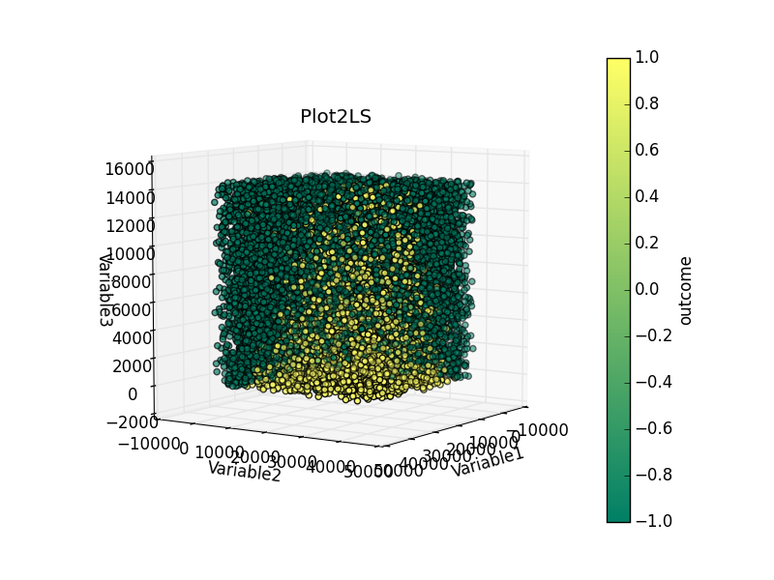
SBO Analysis Visualization
Variable 1: Reactor Power
Variable 2: Diesel Generator Recovery Time
Variable 3: Safety Release Valve (2) Stuck Open Time

Slide 15
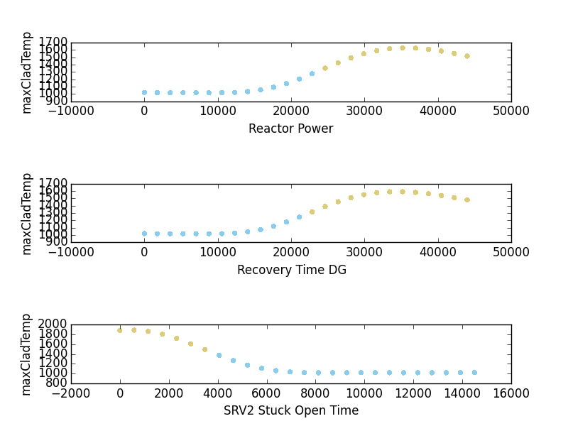
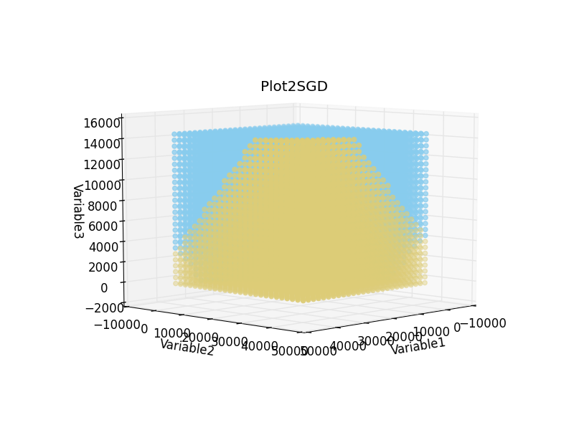
Clustering over Mean Values

Slide 16
Snapshot Approach to Data Mining Algorithms
The data mining algorithm is applied at each time step
This approach is not effective filtering out the noise
Detect outlier

Slide 17
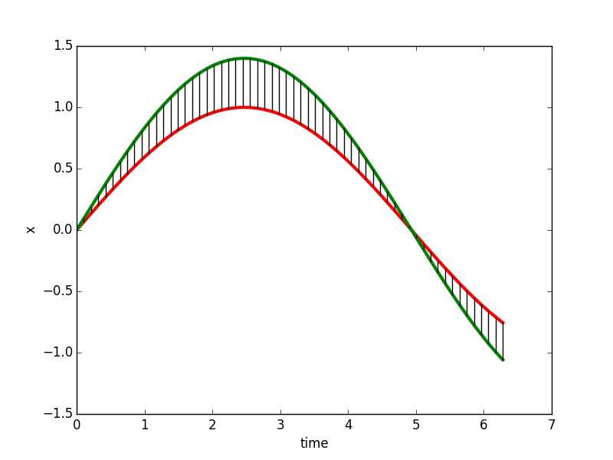
Similarity Metrics
Euclidean
S = [s₁,s₂,.…,s_{N}]
Q = [q₁,q₂,…,q_{N}]
S
Q

Slide 18
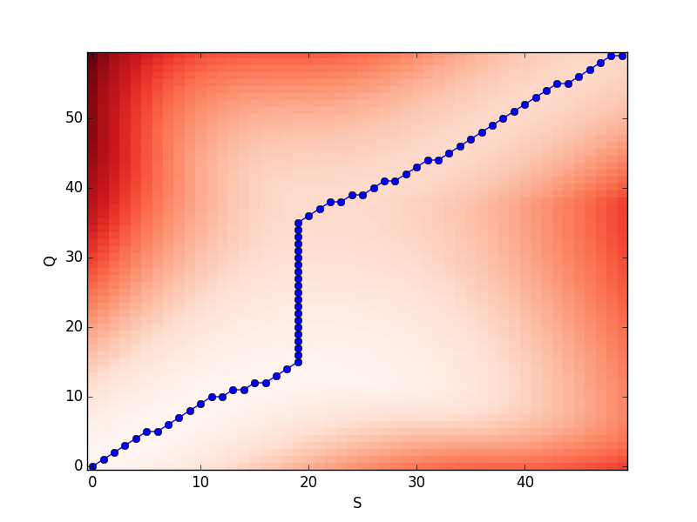
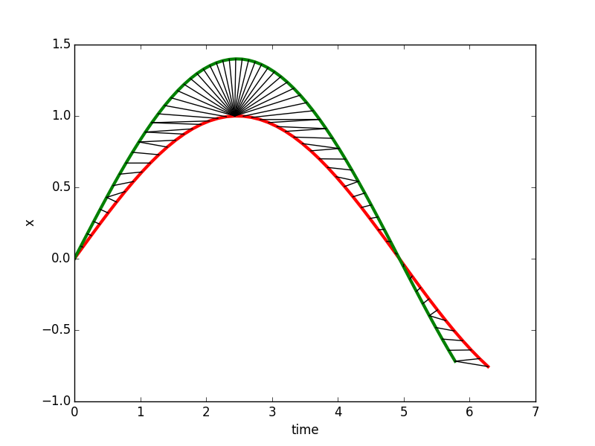
Similarity Metrics
Dynamic Time Warping
S = [s₁,s₂,….,s_{N}]
Q = [q₁,q₂,…,q_{M}]
S
Q

Slide 19
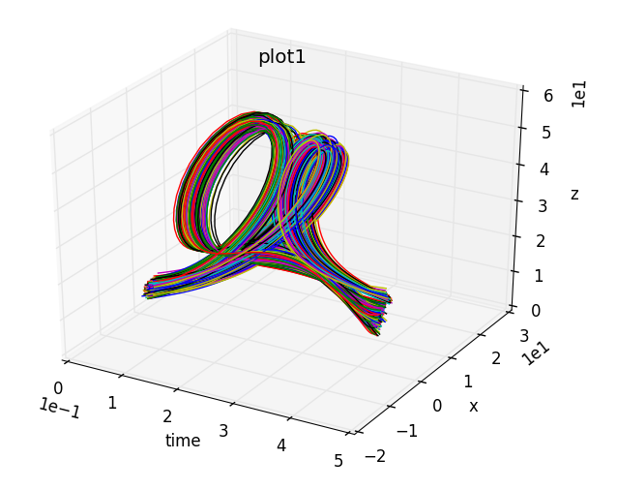
Time-dependent Clustering
Group time series considering full temporal profile
Notes:
Clustering final non rapresentativo del pattern

Slide 20
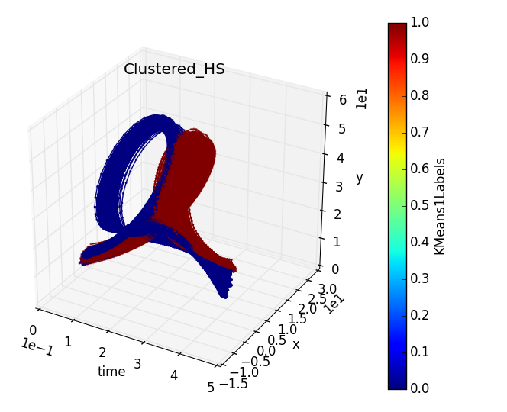
Time-dependent Clustering
Test using K-Means clustering algorithm
2 obtained clusters
Cluster_1
Cluster_0

Slide 21
Time-dependent Clustering
Investigate relationship input vs. output
Notes:
Sampling initial condition

Slide 22
Time-dependent Clustering
Investigate relationship input vs. output

Slide 23
Questions?

